Slide 1
MySQL commands

Slide 2
The SQL CREATE TABLE Statement
The CREATE TABLE statement is used to create a new table in a database.
Syntax
CREATE TABLE table_name ( column1 datatype1(size), column2 datatype2, column3 datatype3, .... ); Ex : create table stud(sno int,sname char(30));
Example :
CREATE TABLE Persons ( PersonID int, LastName varchar(255), FirstName varchar(255), Address varchar(255), City varchar(255) );

Slide 3
Create Table Using Another Table :
A copy of an existing table can also be created using CREATE TABLE
The new table gets the same column definitions. All columns or specific columns can be selected.
If you create a new table using an existing table, the new table will be filled with the existing values from the old table.
Syntax
CREATE TABLE new_table_name AS SELECT column1, column2,... FROM existing_table_name WHERE ....;
The following SQL creates a new table called "TestTables" (which is a copy of the "Customers" table):
Example
CREATE TABLE TestTable AS SELECT customername, contactname FROM customers;

Slide 4
SQL DROP TABLE Statement
The DROP TABLE statement is used to drop an existing table in a database.
Syntax
DROP TABLE table_name;
Note: Be careful before dropping a table. Deleting a table will result in loss of complete information stored in the table!
Example :
DROP TABLE Shippers;
SQL TRUNCATE TABLE
The TRUNCATE TABLE statement is used to delete the data inside a table, but not the table itself.
Syntax
TRUNCATE TABLE table_name;

Slide 5
SQL ALTER TABLE Statement :
The ALTER TABLE statement is used to add, delete, or modify columns in an existing table.
The ALTER TABLE statement is also used to add and drop various constraints on an existing table.
ALTER TABLE - ADD Column
To add a column in a table, use the following syntax:
ALTER TABLE table_name
ADD column_name datatype;
The following SQL adds an "Email" column to the "Customers" table:
ALTER TABLE Customers
ADD Email varchar(255);

Slide 6
ALTER TABLE - DROP COLUMN
To delete a column in a table, use the following syntax (notice that some database systems don't allow deleting a column):
ALTER TABLE table_name DROP COLUMN column_name;
The following SQL deletes the "Email" column from the "Customers" table:
Example
ALTER TABLE Customers DROP COLUMN Email;
ALTER TABLE - ALTER/MODIFY COLUMN
To change the data type of a column in a table, use the following syntax:
My SQL / Oracle (prior version 10G):
ALTER TABLE table_name MODIFY COLUMN column_name datatype;

Slide 7
SQL Create Constraints
Constraints can be specified when the table is created with the CREATE TABLE statement, or after the table is created with the ALTER TABLE statement.
Syntax
CREATE TABLE table_name ( column1 datatype constraint, column2 datatype constraint, column3 datatype constraint, .... );
Constraints can be column level or table level. Column level constraints apply to a column, and table level constraints apply to the whole table.
The following constraints are commonly used in SQL:
NOT NULL - Ensures that a column cannot have a NULL value
UNIQUE - Ensures that all values in a column are different
PRIMARY KEY - A combination of a NOT NULL and UNIQUE. Uniquely identifies each row in a table
FOREIGN KEY - Uniquely identifies a row/record in another table
CHECK - Ensures that all values in a column satisfies a specific condition
DEFAULT - Sets a default value for a column when no value is specified
INDEX - Used to create and retrieve data from the database very quickly

Slide 8
SQL NOT NULL on CREATE TABLE :
The following SQL ensures that the "ID", "LastName", and "FirstName" columns will NOT accept NULL values when the "Persons" table is created:
Example
CREATE TABLE Persons (
ID int NOT NULL,
LastName varchar(255) NOT NULL,
FirstName varchar(255) NOT NULL,
Age int
);
SQL NOT NULL on ALTER TABLE :
To create a NOT NULL constraint on the "Age" column when the "Persons" table is already created, use the following SQL:
ALTER TABLE Persons
MODIFY Age int NOT NULL;

Slide 9
SQL UNIQUE Constraint
The UNIQUE constraint ensures that all values in a column are different.
Both the UNIQUE and PRIMARY KEY constraints provide a guarantee for uniqueness for a column or set of columns.
A PRIMARY KEY constraint automatically has a UNIQUE constraint.
However, you can have many UNIQUE constraints per table, but only one PRIMARY KEY constraint per table.
MySQL:
CREATE TABLE Persons ( ID int NOT NULL, LastName varchar(255) NOT NULL, FirstName varchar(255), Age int, UNIQUE (ID) );
SQL UNIQUE Constraint on ALTER TABLE :
To create a UNIQUE constraint on the "ID" column when the table is already created, use the following SQL:
MySQL / SQL Server / Oracle / MS Access:
ALTER TABLE Persons ADD UNIQUE (ID);

Slide 10
SQL PRIMARY KEY Constraint
The PRIMARY KEY constraint uniquely identifies each record in a table.
Primary keys must contain UNIQUE values, and cannot contain NULL values.
A table can have only ONE primary key; and in the table, this primary key can consist of single or multiple columns (fields).
SQL PRIMARY KEY on CREATE TABLE :
The following SQL creates a PRIMARY KEY on the "ID" column when the "Persons" table is created:
MySQL:
CREATE TABLE Persons (
ID int NOT NULL,
LastName varchar(255) NOT NULL,
FirstName varchar(255),
Age int,
PRIMARY KEY (ID)
);

Slide 11
To allow naming of a PRIMARY KEY constraint, and for defining a PRIMARY KEY constraint on multiple columns, use the following SQL syntax:
MySQL / SQL Server / Oracle / MS Access:
CREATE TABLE Persons (
ID int NOT NULL,
LastName varchar(255) NOT NULL,
FirstName varchar(255),
Age int,
CONSTRAINT PK_Person PRIMARY KEY (ID,LastName)
);
SQL PRIMARY KEY on ALTER TABLE
To create a PRIMARY KEY constraint on the "ID" column when the table is already created, use the following SQL:
MySQL / SQL Server / Oracle / MS Access:
ALTER TABLE Persons ADD PRIMARY KEY (ID);

Slide 12
SQL FOREIGN KEY Constraint
A FOREIGN KEY is a key used to link two tables together.
A FOREIGN KEY is a field (or collection of fields) in one table that refers to the PRIMARY KEY in another table.
The table containing the foreign key is called the child table, and the table containing the candidate key is called the referenced or parent table.
.

Slide 13
The following SQL creates a FOREIGN KEY on the "PersonID" column when the "Orders" table is created:
"Persons" table:
PersonID LastName FirstName Age
1 Hansen Ola 30
2 Svendson Tove 23
3 Pettersen Kari 20
"Orders" table:
OrderID OrderNumber PersonID
1 77895 3
2 44678 3
3 22456 2
4 24562 1
CREATE TABLE Orders ( OrderID int NOT NULL, OrderNumber int NOT NULL, PersonID int, PRIMARY KEY (OrderID), FOREIGN KEY (PersonID) REFERENCES Persons(PersonID) );

Slide 14
SQL CHECK Constraint
The CHECK constraint is used to limit the value range that can be placed in a column.
If you define a CHECK constraint on a single column it allows only certain values for this column.
If you define a CHECK constraint on a table it can limit the values in certain columns based on values in other columns in the row.
SQL CHECK on CREATE TABLE
The following SQL creates a CHECK constraint on the "Age" column when the "Persons" table is created. The CHECK constraint ensures that you can not have any person below 18 years:
MySQL:
CREATE TABLE Persons (
ID int NOT NULL,
LastName varchar(255) NOT NULL,
FirstName varchar(255),
Age int,
CHECK (Age>=18)
);

Slide 15
SQL DEFAULT Constraint :
The DEFAULT constraint is used to provide a default value for a column.
The default value will be added to all new records IF no other value is specified.
SQL DEFAULT on CREATE TABLE
The following SQL sets a DEFAULT value for the "City" column when the "Persons" table is created:
My SQL / SQL Server / Oracle / MS Access:
CREATE TABLE Persons (
ID int NOT NULL,
LastName varchar(255) NOT NULL,
FirstName varchar(255),
Age int,
City varchar(255) DEFAULT 'Sandnes'
);

Slide 16
SQL CREATE INDEX Statement :
The CREATE INDEX statement is used to create indexes in tables.
Indexes are used to retrieve data from the database very fast. The users cannot see the indexes, they are just used to speed up searches/queries.
Note: Updating a table with indexes takes more time than updating a table without (because the indexes also need an update). So, only create indexes on columns that will be frequently searched against.
Creates an index on a table. Duplicate values are allowed:
CREATE INDEX index_name
ON table_name (column1, column2, ...);
CREATE UNIQUE INDEX Syntax :
Creates a unique index on a table. Duplicate values are not allowed:
CREATE UNIQUE INDEX index_name
ON table_name (column1, column2, ...);
Note: The syntax for creating indexes varies among different databases. Therefore: Check the syntax for creating indexes in your database.

Slide 17
CREATE INDEX Example
The SQL statement below creates an index named "idx_lastname" on the "LastName" column in the "Persons" table:
CREATE INDEX idx_lastname
ON Persons (LastName);
If you want to create an index on a combination of columns, you can list the column names within the parentheses, separated by commas:
CREATE INDEX idx_pname
ON Persons (LastName, FirstName);

Slide 18
AUTO INCREMENT Field
Auto-increment allows a unique number to be generated automatically when a new record is inserted into a table.
Often this is the primary key field that we would like to be created automatically every time a new record is inserted.
Syntax for MySQL
The following SQL statement defines the "Personid" column to be an auto-increment primary key field in the "Persons" table:
CREATE TABLE Persons (
Personid int NOT NULL AUTO_INCREMENT,
LastName varchar(255) NOT NULL,
FirstName varchar(255),
Age int,
PRIMARY KEY (Personid)
);
MySQL uses the AUTO_INCREMENT keyword to perform an auto-increment feature.
By default, the starting value for AUTO_INCREMENT is 1, and it will increment by 1 for each new record.
To let the AUTO_INCREMENT sequence start with another value, use the following SQL statement:
ALTER TABLE Persons AUTO_INCREMENT=100;

Slide 19
SQL Date Data Types
MySQL comes with the following data types for storing a date or a date/time value in the database:
DATE - format YYYY-MM-DD
DATETIME - format: YYYY-MM-DD HH:MI:SS
TIMESTAMP - format: YYYY-MM-DD HH:MI:SS
YEAR - format YYYY or YY

Slide 20
DML COMMANDS

Slide 21
The SQL INSERT INTO Statement : The INSERT INTO statement is used to insert new records in a table. INSERT INTO table_name (column1, column2, column3, ...) VALUES (value1, value2, value3, ...); INSERT INTO Customers (CustomerName, ContactName, Address, City, PostalCode, Country) VALUES ('Cardinal', 'Tom B. Erichsen', 'Skagen 21', 'Stavanger', '4006', 'Norway'); The INSERT INTO syntax would be as follows: INSERT INTO table_name VALUES (value1, value2, value3, ...); Insert Data Only in Specified Columns INSERT INTO Customers (CustomerName, City, Country) VALUES ('Cardinal', 'Stavanger', 'Norway');

Slide 22
The SQL UPDATE Statement The UPDATE statement is used to modify the existing records in a table. UPDATE Syntax : UPDATE table_name SET column1 = value1, column2 = value2, ... WHERE condition; Note : If you omit the WHERE clause, all records in the table will be updated! Example : UPDATE Customers SET ContactName = 'Alfred Schmidt', City= 'Frankfurt' WHERE CustomerID = 1;

Slide 23
The SQL DELETE Statement : The DELETE statement is used to delete existing records in a table. DELETE Syntax : DELETE FROM table_name WHERE condition; Example : DELETE FROM Customers WHERE CustomerName='Alfreds Futterkiste'; Delete All Records : It is possible to delete all rows in a table without deleting the table. This means that the table structure, attributes, and indexes will be intact: DELETE FROM table_name;

Slide 24
The SQL SELECT Statement : The SELECT statement is used to select data from a database. The data returned is stored in a result table, called the result-set. SYNTAX : SELECT column1, column2, ... FROM table_name; Example : SELECT CustomerName, City FROM Customers; If you want to select all the fields available in the table. SELECT * FROM table_name; Example : SELECT * FROM Customers;

Slide 25
SELECT DISTINCT Syntax : SELECT DISTINCT column1, column2, ... FROM table_name; -> Removes duplication SELECT DISTINCT Country FROM Customers; The SQL WHERE Clause : The WHERE clause is used to filter records. The WHERE clause is used to extract only those records that fulfill a specified condition. SELECT column1, column2, ... FROM table_name WHERE condition; SELECT * FROM Customers WHERE Country='Mexico';

Slide 26
Operators in The WHERE Clause : The following operators can be used in the WHERE clause: Operator Description Example = Equal > Greater than < Less than >= Greater than or equal <= Less than or equal <> Not equal. Note: In some versions of SQL this operator may be written as != BETWEEN Between a certain range LIKE Search for a pattern IN To specify multiple possible values for a column

Slide 27
The SQL AND, OR and NOT Operators : The WHERE clause can be combined with AND, OR, and NOT operators. The AND and OR operators are used to filter records based on more than one condition: The AND operator displays a record if all the conditions separated by AND are TRUE. The OR operator displays a record if any of the conditions separated by OR is TRUE. The NOT operator displays a record if the condition(s) is NOT TRUE. AND Syntax : SELECT column1, column2, ... FROM table_name WHERE condition1 AND condition2 AND condition3 ...; SELECT * FROM Customers WHERE Country='Germany' AND City='Berlin';

Slide 28
OR Syntax : SELECT column1, column2, ... FROM table_name WHERE condition1 OR condition2 OR condition3 ...; Example : SELECT * FROM Customers WHERE City='Berlin' OR City='München'; NOT Syntax : SELECT column1, column2, ...FROM table_name WHERE NOT condition; Example : SELECT * FROM Customers WHERE NOT Country='Germany'; Combining AND, OR and NOT : SELECT * FROM Customers WHERE Country='Germany' AND (City='Berlin' OR City='München'); SELECT * FROM Customers WHERE NOT Country='Germany' AND NOT Country='USA';

Slide 29
The SQL ORDER BY Keyword : The ORDER BY keyword is used to sort the result-set in ascending or descending order. The ORDER BY keyword sorts the records in ascending order by default. To sort the records in descending order, use the DESC keyword. ORDER BY Syntax : SELECT column1, column2, … FROM table_name ORDER BY column1, column2, ... ASC|DESC; Example : SELECT * FROM Customers ORDER BY Country; SELECT * FROM Customers ORDER BY Country DESC; SELECT * FROM Customers ORDER BY Country, CustomerName; SELECT * FROM Customers ORDER BY Country ASC, CustomerName DESC;

Slide 30
SQL NULL Values : A field with a NULL value is a field with no value. Note: A NULL value is different from a zero value or a field that contains spaces. A field with a NULL value is one that has been left blank during record creation! How to Test for NULL Values? It is not possible to test for NULL values with comparison operators, such as =, <, or <>. We will have to use the IS NULL and IS NOT NULL operators instead. IS NULL Syntax : SELECT column_names FROM table_name WHERE column_name IS NULL; SELECT CustomerName, ContactName, Address FROM Customers WHERE Address IS NULL; IS NOT NULL Syntax : SELECT column_names FROM table_name WHERE column_name IS NOT NULL; SELECT CustomerName, ContactName, Address FROM Customers WHERE Address IS NOT NULL;

Slide 31
Aggregate Functions : SQL MIN() and MAX() Functions The MIN() function returns the smallest value of the selected column. SELECT MIN(column_name) FROM table_name WHERE condition; SELECT MIN(Price) FROM Products; The MAX() function returns the largest value of the selected column. SELECT MAX(column_name) FROM table_name WHERE condition; SELECT MAX(Price) FROM Products;

Slide 32
The SQL COUNT(), AVG() and SUM() Functions : The COUNT() function returns the number of rows that matches a specified criteria. The AVG() function returns the average value of a numeric column. The SUM() function returns the total sum of a numeric column. COUNT() Syntax : SELECT COUNT(column_name) FROM table_name WHERE condition; SELECT COUNT(ProductID) FROM Products; AVG() Syntax : SELECT AVG(column_name) FROM table_name WHERE condition; SELECT AVG(Price) FROM Products; SUM() Syntax : SELECT SUM(column_name) FROM table_name WHERE condition; SELECT SUM(Quantity) FROM OrderDetails;

Slide 33
The SQL LIKE Operator : The LIKE operator is used in a WHERE clause to search for a specified pattern in a column. There are two wildcards often used in conjunction with the LIKE operator: % - The percent sign represents zero, one, or multiple characters _ - The underscore represents a single character The percent sign and the underscore can also be used in combinations! LIKE Syntax : SELECT column1, column2, ... FROM table_name WHERE column LIKE pattern; Tip: You can also combine any number of conditions using AND or OR operators.

Slide 34
Here are some examples showing different LIKE operators with '%' and '_' wildcards: LIKE Operator Description : WHERE CustomerName LIKE 'a%' Finds any values that start with "a" WHERE CustomerName LIKE '%a' Finds any values that end with "a" WHERE CustomerName LIKE '%or%' Finds any values that have "or" in any position WHERE CustomerName LIKE '_r%' Finds any values that have "r" in the second position WHERE CustomerName LIKE 'a__%' Finds any values that start with "a" and are at least 3 characters in length WHERE ContactName LIKE 'a%o' Finds any values that start with "a" and ends with "o"

Slide 35
Examples : The following SQL statement selects all customers with a CustomerName starting with "a": SELECT * FROM Customers WHERE CustomerName LIKE 'a%'; The following SQL statement selects all customers with a CustomerName ending with "a": SELECT * FROM Customers WHERE CustomerName LIKE '%a'; The following SQL statement selects all customers with a CustomerName that have "or" in any position: SELECT * FROM Customers WHERE CustomerName LIKE '%or%'; The following SQL statement selects all customers with a CustomerName that have "r" in the second position: SELECT * FROM Customers WHERE CustomerName LIKE '_r%'; The following SQL statement selects all customers with a CustomerName that starts with "a" and are at least 3 characters in length: SELECT * FROM Customers WHERE CustomerName LIKE 'a__%';

Slide 36
The following SQL statement selects all customers with a ContactName that starts with "a" and ends with "o": SELECT * FROM Customers WHERE ContactName LIKE 'a%o'; The following SQL statement selects all customers with a CustomerName that does NOT start with "a": SELECT * FROM Customers WHERE CustomerName NOT LIKE 'a%';

Slide 37
The SQL IN Operator : The IN operator allows you to specify multiple values in a WHERE clause. The IN operator is a shorthand for multiple OR conditions. SELECT column_name(s) FROM table_name WHERE column_name IN (value1, value2, ...); SELECT column_name(s) FROM table_name WHERE column_name IN (SELECT STATEMENT); The following SQL statement selects all customers that are located in "Germany", "France" and "UK": SELECT * FROM Customers WHERE Country IN ('Germany', 'France', 'UK'); The following SQL statement selects all customers that are NOT located in "Germany", "France" or "UK": SELECT * FROM Customers WHERE Country NOT IN ('Germany', 'France', 'UK'); The following SQL statement selects all customers that are from the same countries as the suppliers: SELECT * FROM Customers WHERE Country IN (SELECT Country FROM Suppliers);

Slide 38
The SQL BETWEEN Operator : The BETWEEN operator selects values within a given range. The values can be numbers, text, or dates. The BETWEEN operator is inclusive: begin and end values are included. SELECT column_name(s) FROM table_name WHERE column_name BETWEEN value1 AND value2; The following SQL statement selects all products with a price BETWEEN 10 and 20: SELECT * FROM Products WHERE Price BETWEEN 10 AND 20; NOT BETWEEN Example : To display the products outside the range of the previous example, use NOT BETWEEN: SELECT * FROM Products WHERE Price NOT BETWEEN 10 AND 20;

Slide 39
BETWEEN with IN Example : The following SQL statement selects all products with a price BETWEEN 10 and 20. In addition; do not show products with a CategoryID of 1,2, or 3: SELECT * FROM Products WHERE Price BETWEEN 10 AND 20 AND NOT CategoryID IN (1,2,3); BETWEEN Text Values Example : The following SQL statement selects all products with a ProductName BETWEEN Carnarvon Tigers and Mozzarella di Giovanni: SELECT * FROM Products WHERE ProductName BETWEEN 'Carnarvon Tigers' AND 'Mozzarella di Giovanni‘ ORDER BY ProductName; BETWEEN Dates Example : The following SQL statement selects all orders with an OrderDate BETWEEN '01-July-1996' and '31-July-1996': SELECT * FROM Orders WHERE OrderDate BETWEEN #01/07/1996# AND #31/07/1996#; (or) SELECT * FROM Orders WHERE OrderDate BETWEEN '1996-07-01' AND '1996-07-31';

Slide 40
SQL Aliases : SQL aliases are used to give a table, or a column in a table, a temporary name. Aliases are often used to make column names more readable. An alias only exists for the duration of the query. Alias Column Syntax: SELECT column_name AS alias_name FROM table_name; SELECT CustomerID AS ID, CustomerName AS Customer FROM Customers; SELECT CustomerName AS Customer, ContactName AS [Contact Person] FROM Customers; Alias Table Syntax : SELECT column_name(s) FROM table_name AS alias_name; SELECT o.OrderID, o.OrderDate, c.CustomerName FROM Customers AS c, Orders AS o WHERE c.CustomerName="Around the Horn" AND c.CustomerID=o.CustomerID;

Slide 41
The SQL GROUP BY Statement : The GROUP BY statement group rows that have the same values into summary rows, like "find the number of customers in each country". The GROUP BY statement is often used with aggregate functions (COUNT, MAX, MIN, SUM, AVG) to group the result-set by one or more columns. GROUP BY Syntax : SELECT column_name(s) FROM table_name WHERE condition GROUP BY column_name(s) ORDER BY column_name(s); SELECT COUNT(CustomerID), Country FROM Customers GROUP BY Country; SELECT COUNT(CustomerID), Country FROM Customers GROUP BY Country ORDER BY COUNT(CustomerID) DESC;

Slide 42
The SQL HAVING Clause The HAVING clause was added to SQL because the WHERE keyword could not be used with aggregate functions. HAVING Syntax : SELECT column_name(s) FROM table_name WHERE condition GROUP BY column_name(s) HAVING condition ORDER BY column_name(s); Example : The following SQL statement lists the number of customers in each country. Only include countries with more than 5 customers: SELECT COUNT(CustomerID), Country FROM Customers GROUP BY Country HAVING COUNT(CustomerID) > 5;

Slide 43
The following SQL statement lists the number of customers in each country, sorted high to low (Only include countries with more than 5 customers): SELECT COUNT(CustomerID), Country FROM Customers GROUP BY Country HAVING COUNT(CustomerID) > 5 ORDER BY COUNT(CustomerID) DESC;

Slide 44
JOINS :
MySQL JOINS are used with SELECT statement. It is used to retrieve data from multiple tables. It is performed whenever you need to fetch records from two or more tables.
There are three types of MySQL joins:
MySQL INNER JOIN (or sometimes called simple join)
MySQL LEFT OUTER JOIN (or sometimes called LEFT JOIN)
MySQL RIGHT OUTER JOIN (or sometimes called RIGHT JOIN)

Slide 45
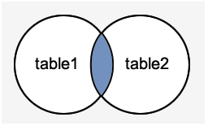
MySQL Inner JOIN (Simple Join)
The MySQL INNER JOIN is used to return all rows from multiple tables where the join condition is
satisfied. It is the most common type of join.
Syntax:
SELECT columns
FROM table1
INNER JOIN table2
ON table1.column = table2.column;

Slide 46
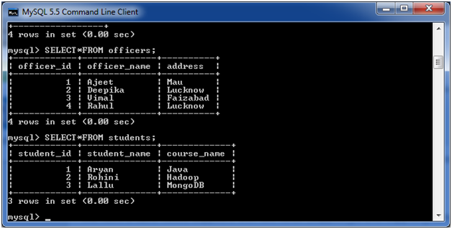

Slide 47
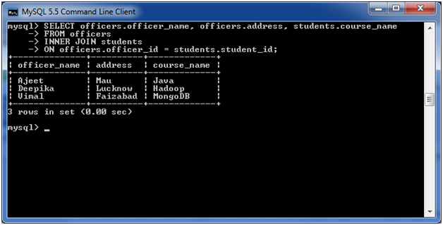
SELECT officers.officer_name, officers.address, students.course_name
FROM officers
INNER JOIN students
ON officers.officer_id = students.student_id;

Slide 48
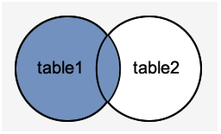
MySQL Left Outer Join
The LEFT OUTER JOIN returns all rows from the left hand table specified in the ON condition and only those rows from the other table where the join condition is fulfilled.
Syntax:
SELECT columns
FROM table1
LEFT [OUTER] JOIN table2
ON table1.column = table2.column;
Image representation:

Slide 49
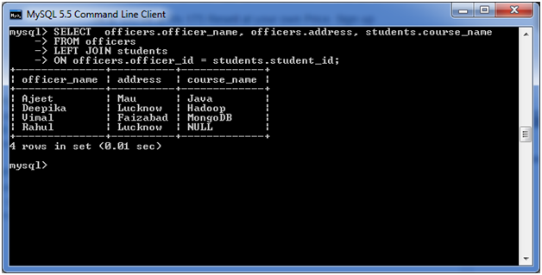
SELECT officers.officer_name, officers.address, students.course_name
FROM officers
LEFT JOIN students
ON officers.officer_id = students.student_id;

Slide 50
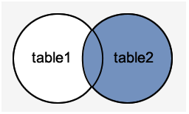
MySQL Right Outer Join
The MySQL Right Outer Join returns all rows from the RIGHT-hand table specified in the ON condition and only those rows from the other table where he join condition is fulfilled.
Syntax:
SELECT columns
FROM table1
RIGHT [OUTER] JOIN table2
ON table1.column = table2.column;

Slide 51
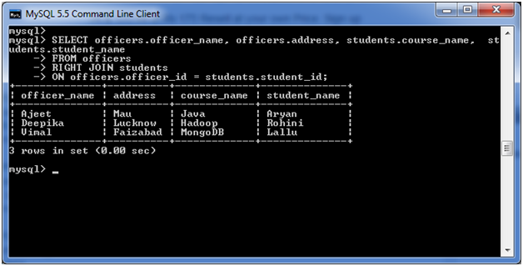
SELECT officers.officer_name, officers.address, students.course_name
FROM officers
RIGHT JOIN students
ON officers.officer_id = students.student_id;

